Slide 1
X-section U-V
See Cross section locations.kmz & Cross section labels.kmz for location in Google Earth

Slide 2
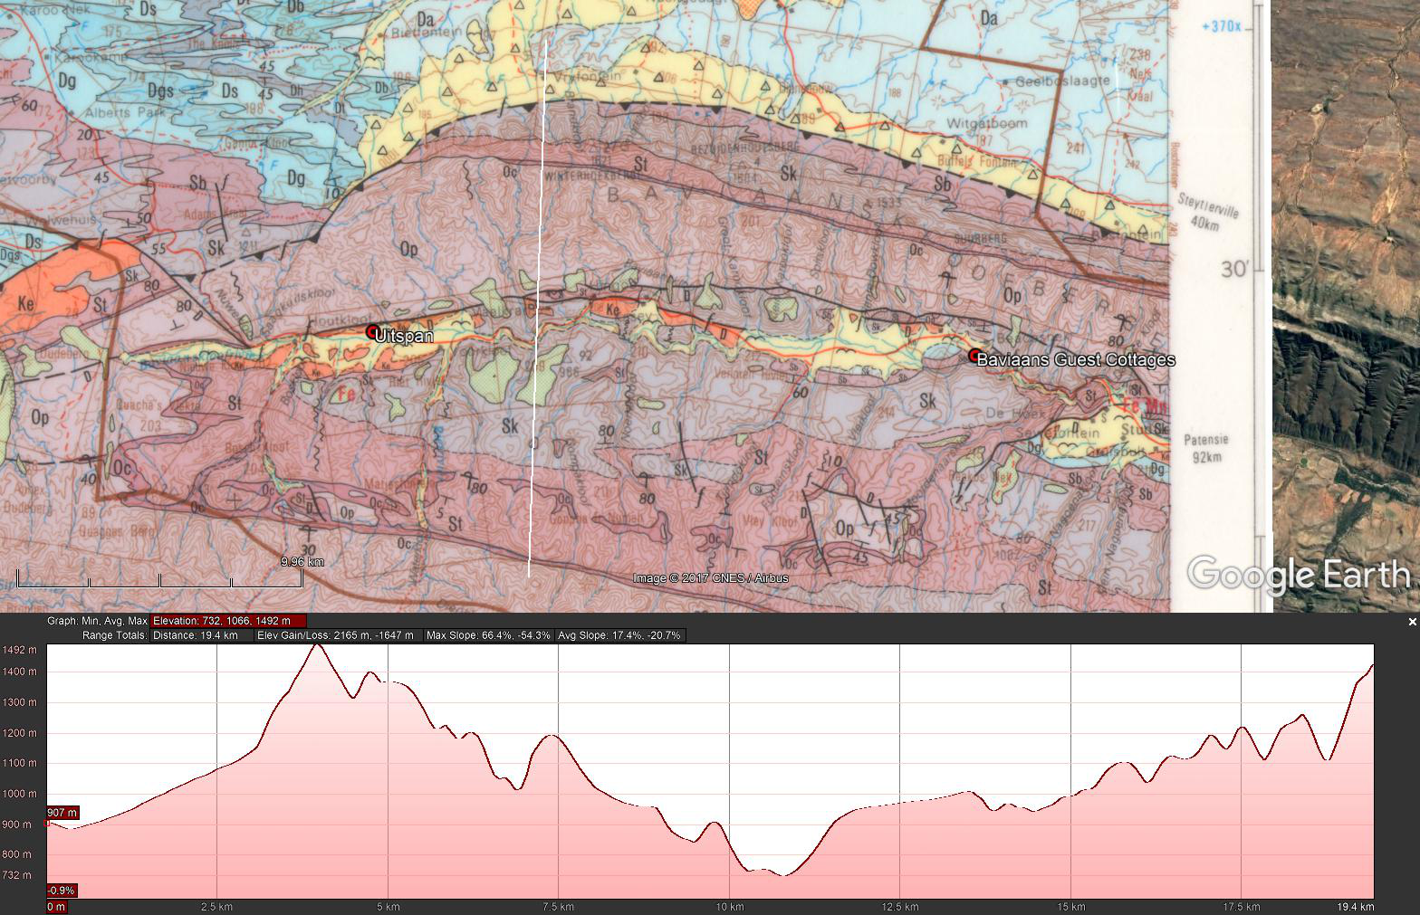
U
Duiwelskloof Lodge
Show elevation profile in Google Earth

Slide 3
U
Duiwelskloof Lodge
V
masl
N-S Geologic Sketch Section U-V Through Duiwelskloof Showing the Thrust
1 400
Duiwelskloof Lodge
1 400
Thrust
Sk
1 200
St
1 200
Sb
Op
African Erosion Surface
1 000
Da
Sk
1 000
St
Sk
St
Op
800
Db
Sk
800
Ds
St
600
Dgs
Oc
600
Dt
Dg
Op
400
Dh
N
400
200
Sb
Sk
St
Op
N
200
Ds
U
V

Slide 4
Extract from presentation given to the South Cape Section of the MCSA in 2019 on the possible origin of the Baviaanskloof slot canyons

Slide 5


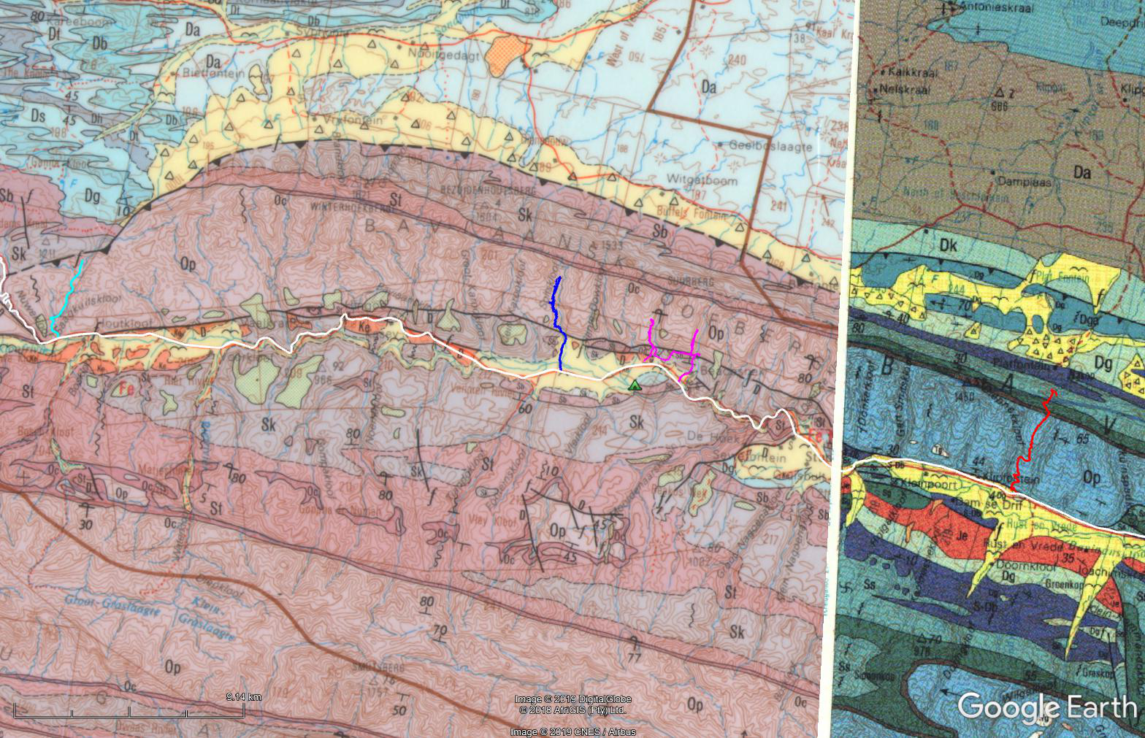
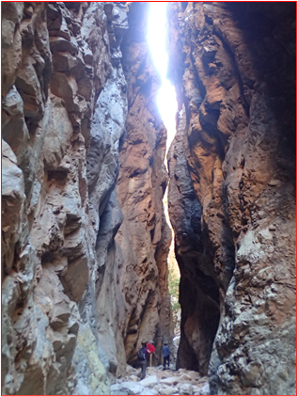
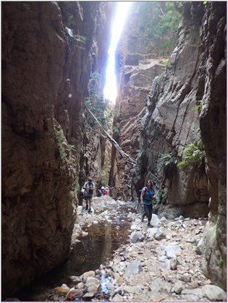
Geology of Slot Canyons

Slide 6
Peninsula Formation Sandstone
500 Ma: Deposition, burial to 15 km depth
260 Ma: Cape folding , uplift to 6 km above SL
Folding: E-W buckling and N-S folding
N-S thrusting

Slide 7
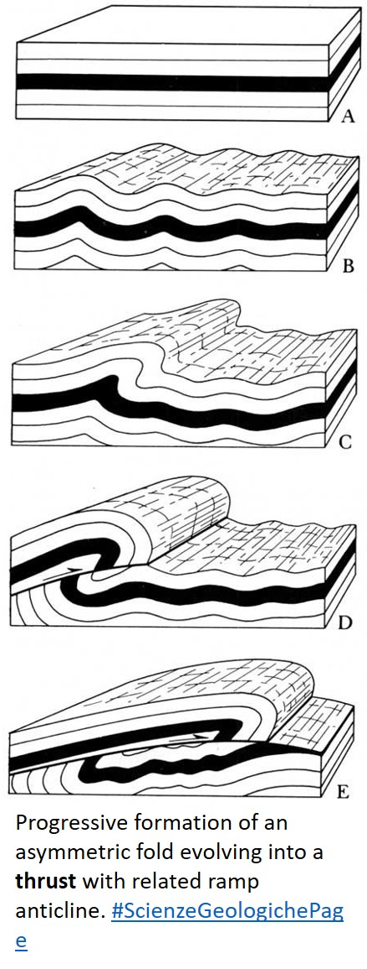
Evolution of a Thrust Fault
Sedimentary layers – UNFOLDED
Compressive force, sedimentary layers begin to FOLD. Formation of parallel Transverse and longitudinal JOINTING
Increasing compressive force, OVER FOLDING, JOINTING
Increasing compressive force, THRUSTING, JOINTING
Increasing compressive force, THRUST RAMP, STRONG JOINT SET

Slide 8
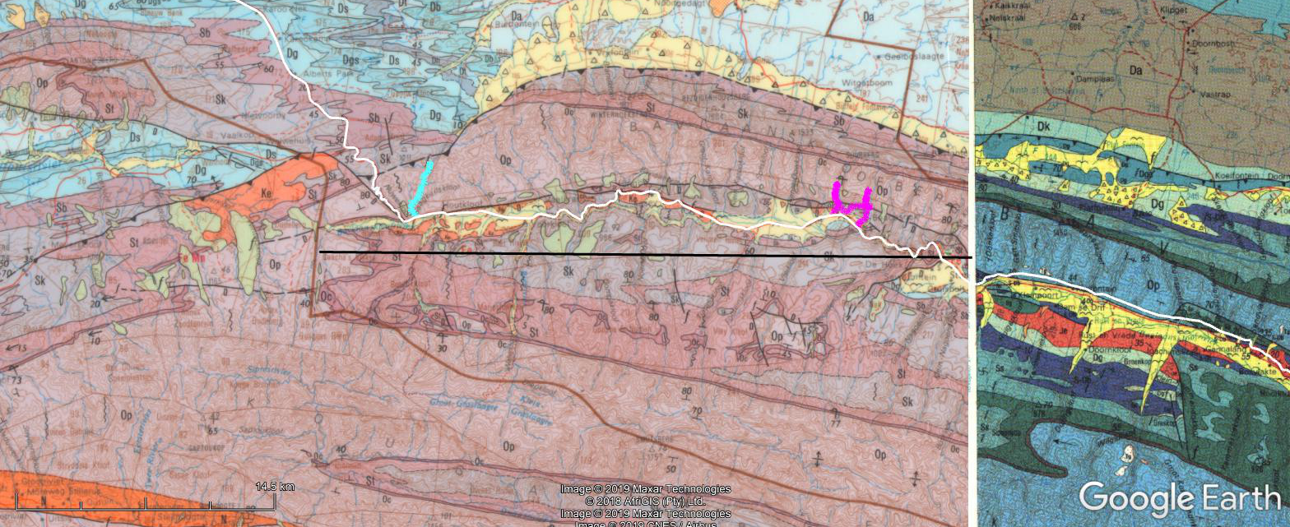
Geological Section W-E
W
E
W
E

Slide 9
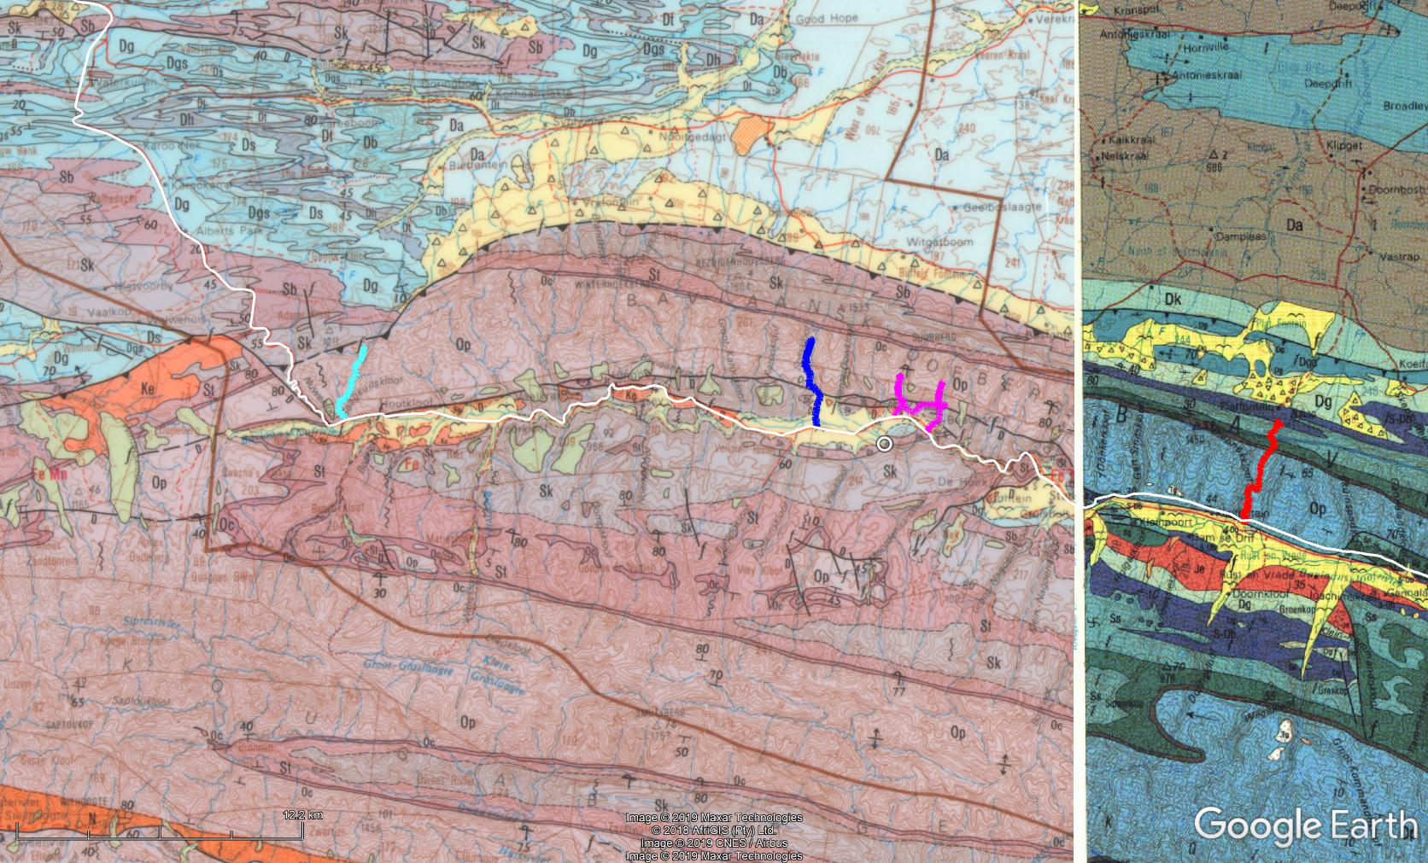
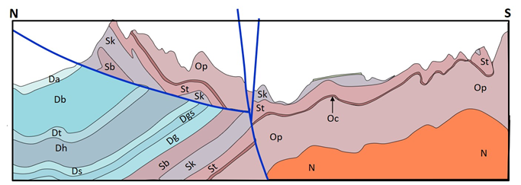
Cross-section Line N-S
N
W
E
S

Slide 10
Evolution of a Thrust Fault
St
Da
Sk
Op
Db
Dgs
St
Oc
Dt
Dg
Op
Dh
N
Ds
Sb
Sk
St
N

Slide 11
Evolution of a Thrust Fault
St
Da
Sk
Op
Db
Dgs
St
Oc
Dt
Dg
Op
Dh
N
Ds
Sb
Sk
St
N

Slide 12
Evolution of a Thrust Fault
Da
St
Db
Op
Dgs
Sk
Dt
St
Dg
Oc
Dh
Sb
Sk
Op
Ds
St
N
N

Slide 13
Evolution of a Thrust Fault
Da
St
Db
Op
Dgs
Sk
Dt
St
Dg
Oc
Dh
Sb
Sk
Op
Ds
St
N
N

Slide 14
Evolution of a Thrust Fault
Da
St
Db
Op
Dgs
Sk
Dt
St
Dg
Oc
Dh
Op
Ds
Sb
Sk
St
N
N

Slide 15
Evolution of a Thrust Fault
Da
St
Db
Op
Dgs
Sk
Dt
St
Dg
Oc
Dh
Op
Ds
Sb
Sk
St
N
N

Slide 16
Evolution of a Thrust Fault
Da
Db
Dgs
Dt
Dg
Dh
Ds
Sb
Sk
St
St
Sk
Op
St
Oc
Op
N
N

Slide 17
Evolution of a Thrust Fault
Da
Db
Dgs
Dt
Dg
Dh
Ds
Sb
Sk
St
St
Sk
Op
St
Oc
Op
N
N

Slide 18
Evolution of a Thrust Fault
Da
Db
Dgs
Dt
Dg
Dh
Ds
Sb
Sk
St
St
Sk
Op
St
Oc
Op
N
N

Slide 19
Evolution of a Thrust Fault
St
Da
Sk
Op
Db
Dgs
St
Oc
Dt
Dg
Op
Dh
N
Ds
Sb
Sk
St
N

Slide 20
Impact of African Erosion Event
140 – 18 Ma: African Erosion Surface
Initial warm humid climate in early Cretaceous changing to semi-arid to arid climate, development of deep weathering profiles capped by duricrusts (AES)

Slide 21
Geological Section W-E
W
E
African Erosion Surface
W
E

Slide 22
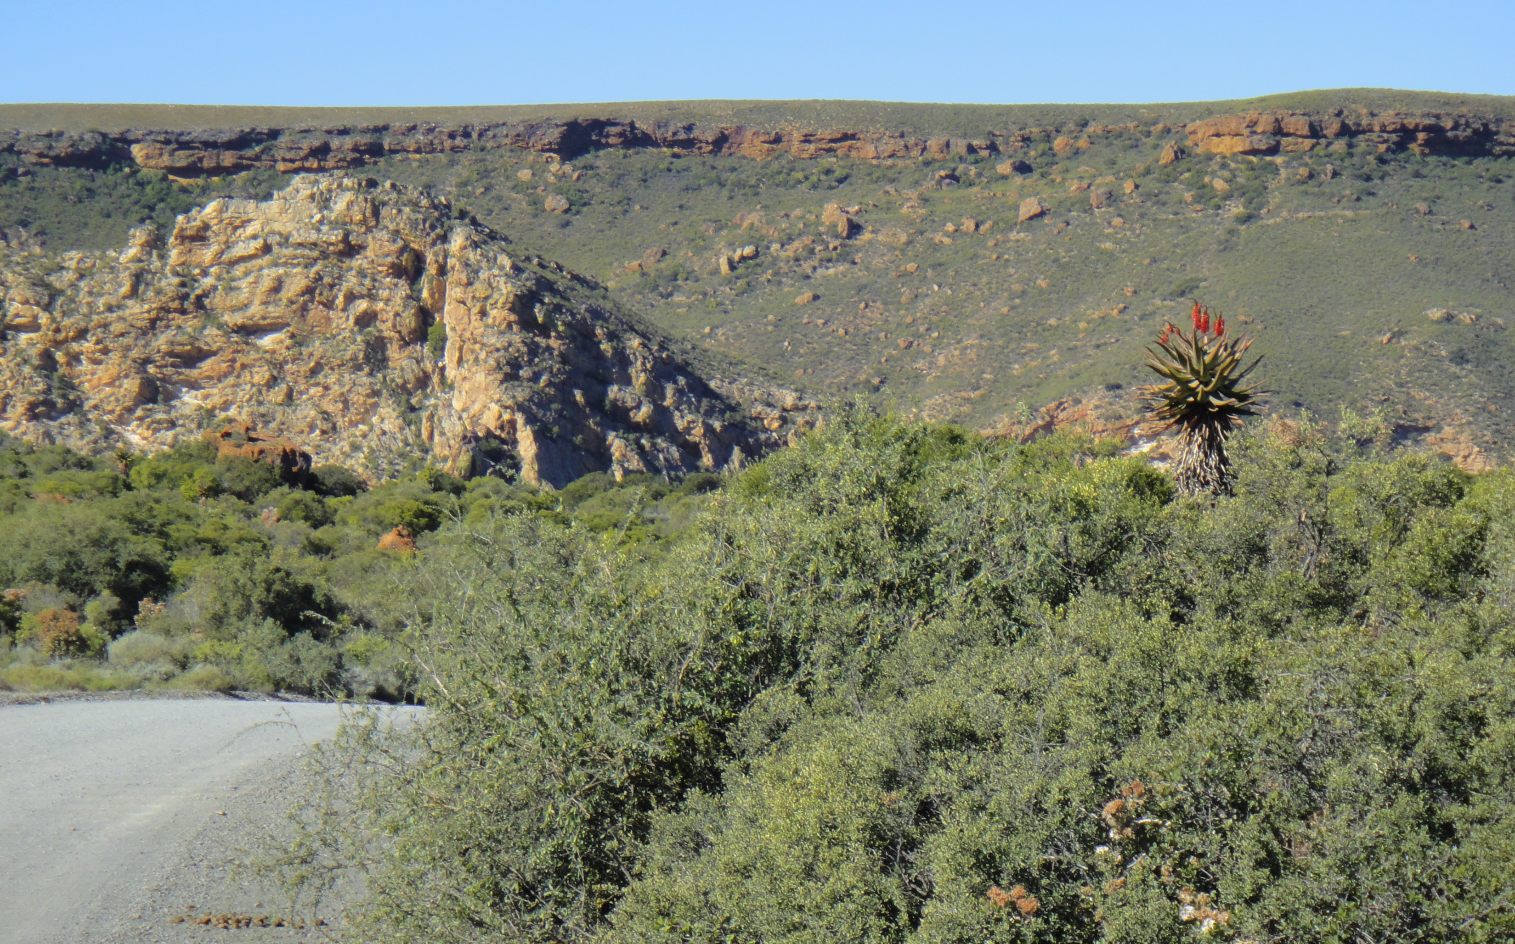
African Erosion Surface

Slide 23
Summarizing …
TMS is the most weathering-resistant and brittle rock unit in our mountains.
During folding, stretching causes a set of parallel cracks (transverse joints) to form
During subsequent thrusting, buckling in the ramp above the thrust plane greatly enhances previously formed joints

Slide 24
Summarizing …
120 million years of intense weathering in the water table zone, further weakens (opens up) the joints
Run-off water exploits these zones of weakness
The above combination of geological events resulted in the formation of the Baviaanskloof slot canyons

